Slide 1


BENQ HR Analytics Dashboard Power BI Project
Data Analytics Track | DEPI Egypt

Slide 2


Project Goal Overview
An interactive Power BI dashboard that enables HR departments to analyze employee satisfaction, attrition, and salary data, supporting data-driven decision-making

Slide 3

Problem Statement
High employee turnover is costly.
Salary trends impact retention and engagement.
Employee satisfaction affects productivity.

Slide 4
Attrition Rate
Visualize employee turnover to improve retention strategies.
Salary Analysis
Identify salary gaps to ensure fair and competitive compensation.
Satisfaction Rate
Monitor employee engagement and spot areas for improvement.
Objectives / Key Metrics

Slide 5

Meet the Team
Ibrahim Kamal Alzayat
Zeyad Mahmoud
Abdelrahman
Hassan Magdy Elshaer
Hager Gamal
Mariam Mustafa
Project Lead – Oversees overall project progress, ensures integration of dashboards.
Data Expert – Cleans, organizes, and unifies datasets.
Design & UI Lead – Standardizes visual design and integrates dashboards.
Insights Analyst – Reviews dashboards to ensure actionable business insights.
Dashboard Developer – Focuses on building and designing dashboards.

Slide 6



Workflow
Data Collection
Data Cleaning & Preparation
Dashboard Design & Development
Data Analysis & KPI Extraction
Insights & Recommendations

Slide 7
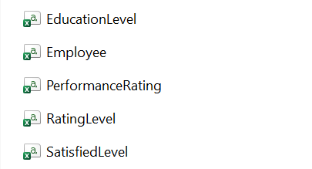
Workflow - Data Collection
Simulated HR dataset provided by the organizers, representing employee data from the technology company BenQ.

Slide 8
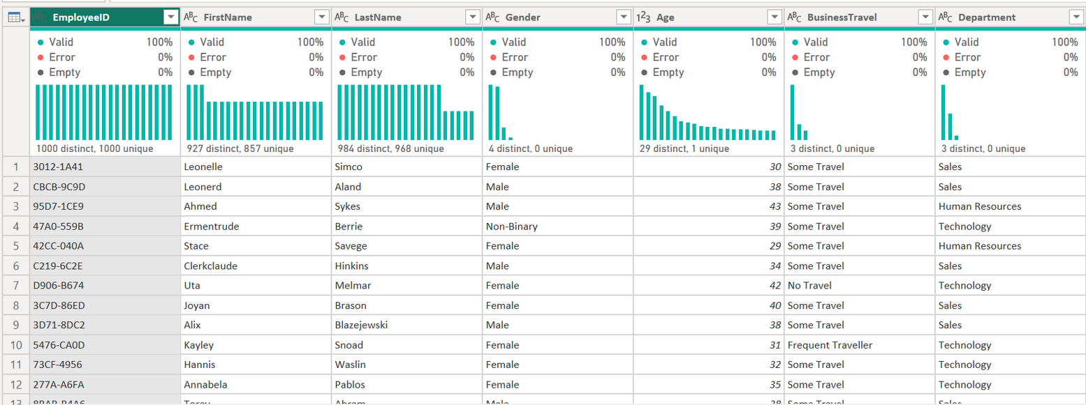

Workflow - Data Cleaning & Preparation
Source Connection: Securely integrated the raw data source to enable live data refresh.
Schema Definition: Designated definitive column headers to structure the data model.
Type Casting: Enforced strict data types to guarantee calculation accuracy.
Duplication Removal: Removed identical records to ensure unique transaction reporting.
Data Integrity: Eliminated all blank and null rows for table completeness.
Power Query - Data Transformation

Slide 9

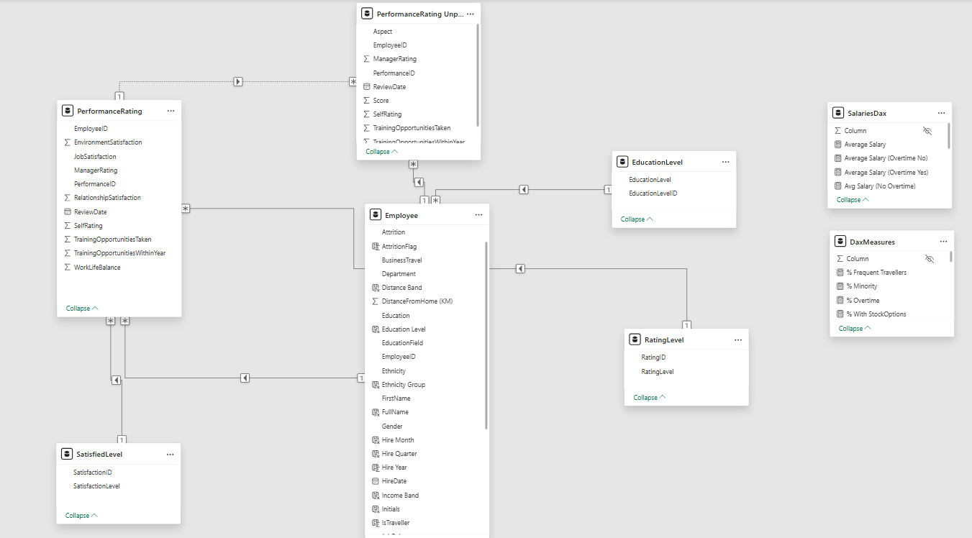
Workflow - Data Modeling
The data model links all key tables to provide a unified view of HR data.
All DAX measures we created are collected in a dedicated tables, powering KPIs like Attrition Rate, Average Salary, and Satisfaction Score.

Slide 10


Workflow - Dashboard Design & Development
Home Page

Slide 11

Data Analysis & KPI Extraction
Attrition Rate: 16%
Satisfaction Index: 71%
salary range: 527k
The employee attrition rate stands at 16% of the total workforce of 1,470 employees. This indicates that approximately 235 employees have left, highlighting potential challenges in retention and workforce stability.”
A 71% Satisfaction Index reflects a solid level of employee satisfaction with opportunities to enhance engagement further.
The total annual salary expenditure reaches 166M, with HR Management holding the highest pay range.

Slide 12
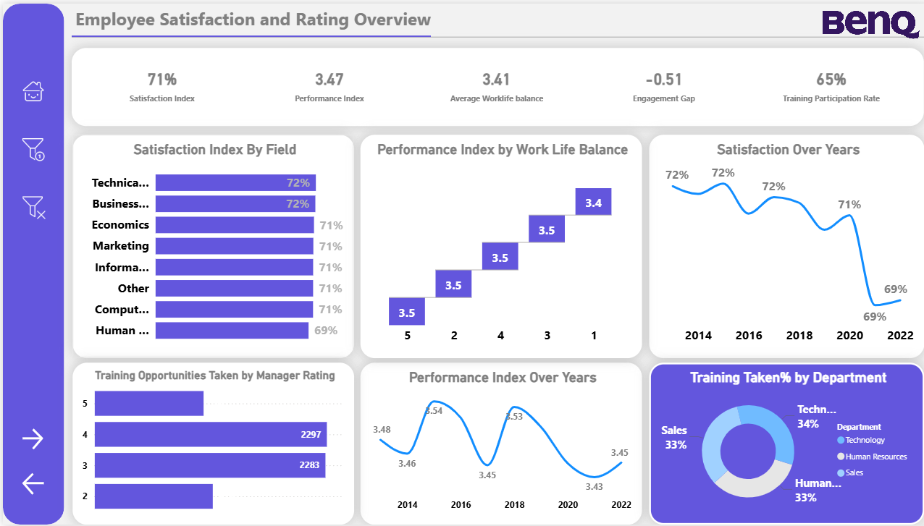
Satisfaction Dashboard
Track changes in employee satisfaction, work-life balance, and performance over time.
Highlight areas needing improvement to enhance overall engagement and productivity.

Slide 13
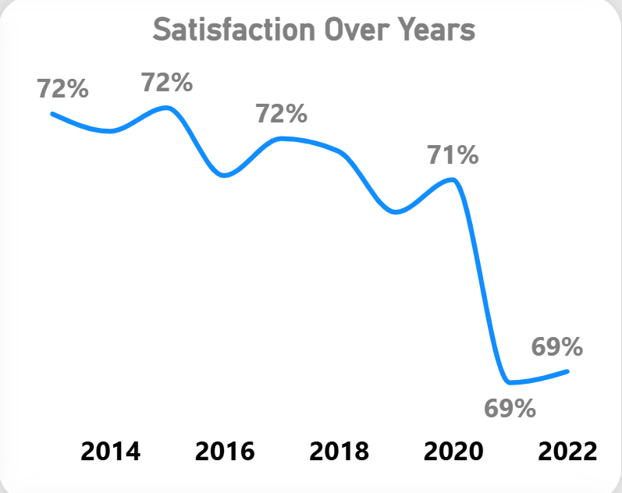
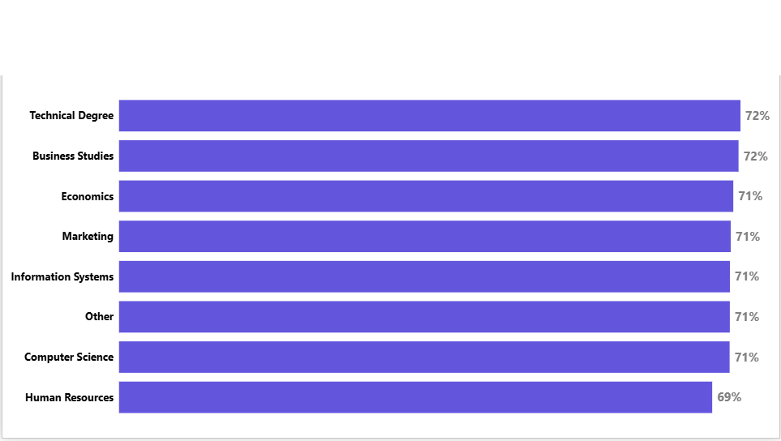
Satisfaction Insights
Satisfaction Over Years
This line chart shows a gradual decline in employee satisfaction from 72% in 2014 to 69% in 2022.
Satisfaction remained stable for several years but dropped sharply after 2020, which may be linked to organizational changes or post-pandemic challenges.
Satisfaction Index by Field
This bar chart shows satisfaction levels across different fields.
Technical & Business Support: Highest at 72% Human Resources: Lowest at 69%

Slide 14
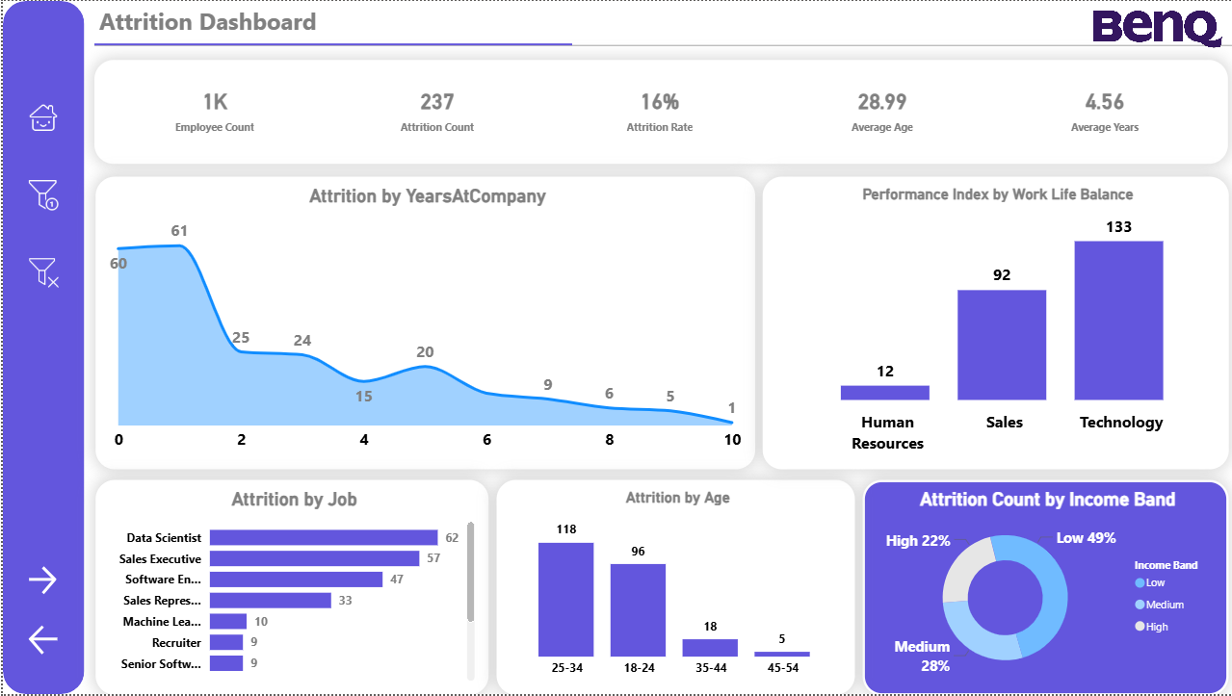
Attrition Dashboard
This dashboard summarizes employee turnover across the company. The company has 1K employees and experienced 237 attritions, resulting in an Attrition Rate of 16%. The average age of employees is 28.99, with an average tenure of 4.56 years. Key turnover drivers include Years At Company, Job Role, Age, Income Band, and Performance Index (by Department).

Slide 15
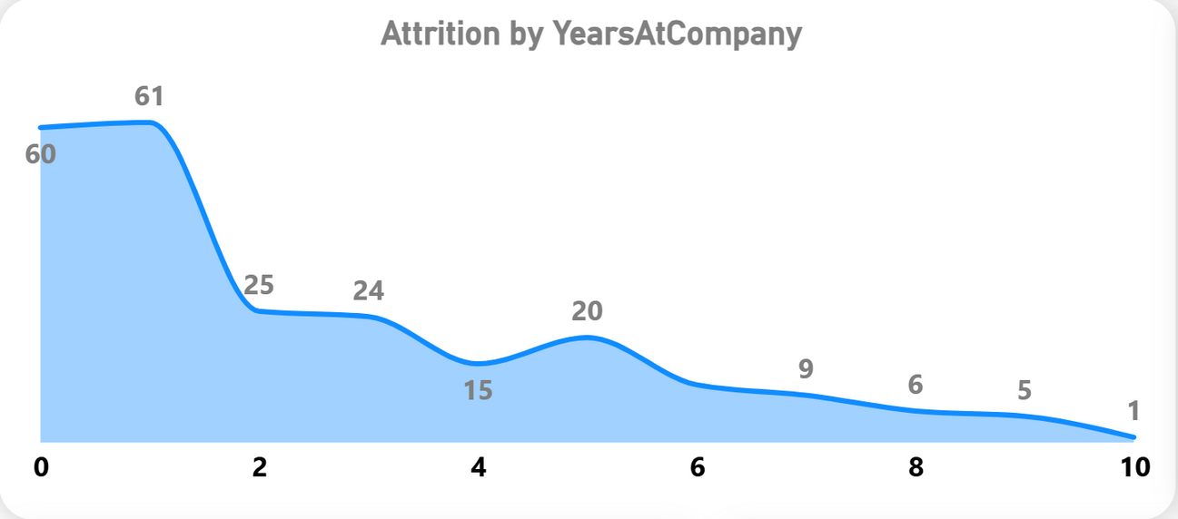
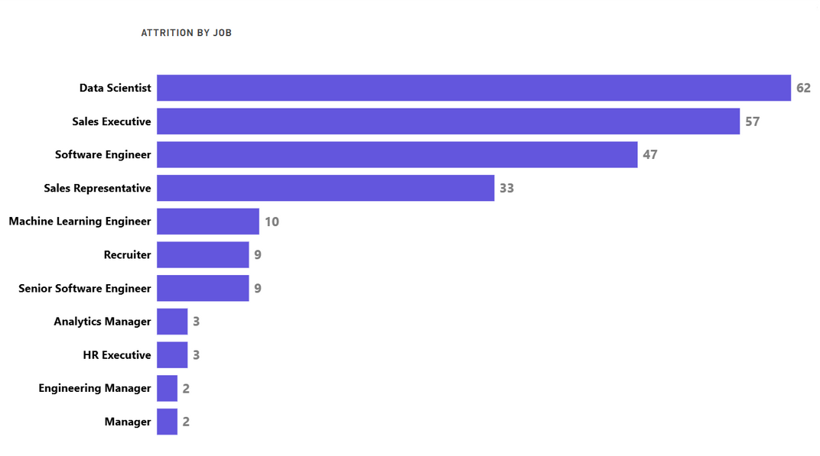
Attrition Insights
Attrition by Years At Company (Early Turnover)
The highest number of attritions, 61 employees, occurs in the first year (0 years), indicating a significant issue with new hire retention, onboarding, or job expectation alignment.
Attrition by Job Role
Data Scientist (62) and Sales Executive (57) roles account for the highest attrition numbers, suggesting these critical, specialized roles are facing the most significant retention challenges.

Slide 16

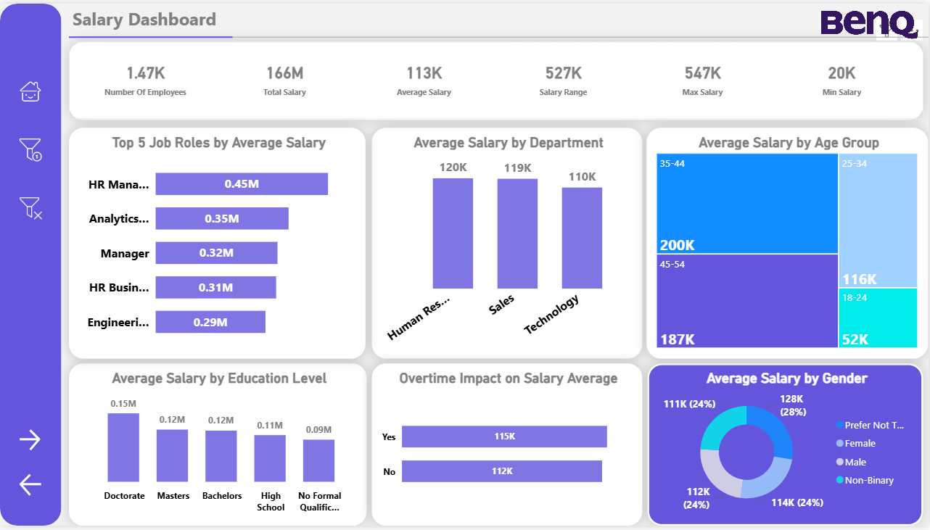
Salary Dashboard
This dashboard provides a concise overview of the company's salary structure, covering 1.47K employees with a Total Salary of 166M and an Average Salary of 113K. The salary range spans from 20K (Min) to 547K (Max).
Key insights reveal trends across Job Roles, Departments, Age Groups, Education Levels, Overtime, and Gender.
Provides transparency in payroll analysis, detects pay gaps, and helps design fair and competitive compensation strategies.

Slide 17
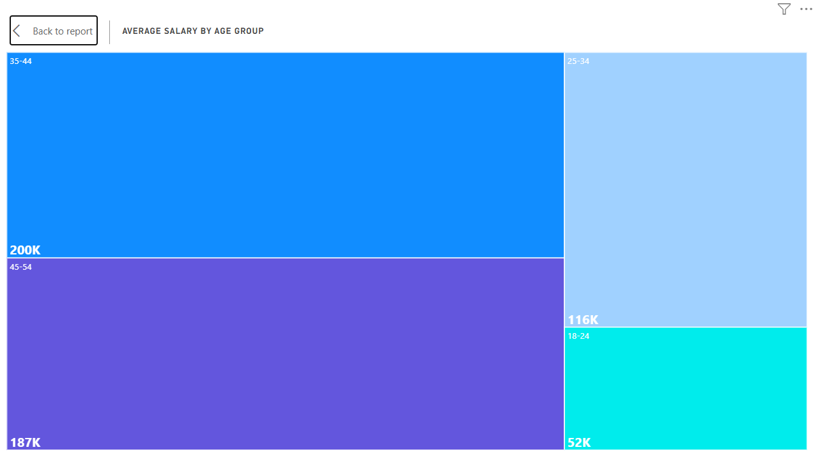
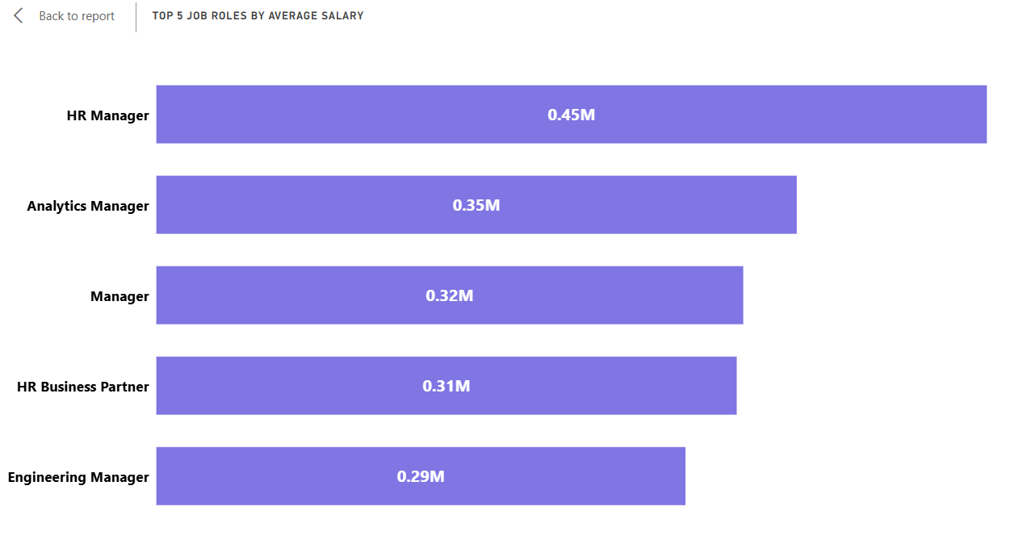
Salary Insights
Average Salary by Age Group
Employees in the 45-54 age group earn the highest average salary (200K), followed closely by the 35-44 age group (187K), showing a strong positive correlation between experience/seniority and compensation.
Top 5 Job Roles by Average Salary
HR Manager has the highest average salary (0.45M), significantly outpacing other roles, including Engineering (0.29M).

Slide 18
Recommendations & Next Steps
Boost Employee Engagement:
Address post-2020 satisfaction decline through feedback programs, wellness initiatives, and stronger communication especially within HR teams.
Reduce Early Turnover:
Strengthen onboarding and clarify job expectations to retain new hires during their first year.
Retain Key Talent:
Focus retention strategies on Data Scientists and Sales Executives with clear growth paths and performance-based incentives.
Review Pay Structures:
Ensure compensation is fair and consistent across roles to maintain motivation and equity.
Monitor Progress Continuously:
Keep dashboards updated to track improvements and guide future HR strategies.

Slide 19


